Slide 1

Computer Engineering Department A.P. Shah Institute of Technology G.B.Road,Kasarvadavli, Thane(W), Mumbai-400615 UNIVERSITY OF MUMBAI Academic Year 2021-2022

Slide 2
Synopsis on STOCK TRADING WEBAPP Submitted in partial fulfillment of the degree of Bachelor of Engineering(Sem-3) in Computer Engineering By VIDUL BHOSALE(20102152) PARTH MISHRA(20102162) JAINAM GALA(20102112)
ADWAIT BAPAT(20102158) Under the Guidance of PROF. RRB

Slide 3
Abstract
It is a web application for stock market data. Users can get real-time stock data and market news via Alpha Vantage, IEX Cloud, and Stock News APIs.
Creation of personal stock portfolios and a live streaming news feed are the first features.
The authorization process should be as simple as possible and, most importantly, secure (when it comes to finances, the issue of data security is especially relevant).

Slide 4
1.1 Problem Definition
To make a stock trade learning webapp that reduces the risk for new comers and is less vulnerable to scams and frauds also help learning the inability to read stock trends

Slide 5
1.2 Objectives
To Create A Easy To Use Clone.
To Try And Simplify The The Trends Of Stocks Based On
Previous Performance
To Give A Real Feeling Of A Legit Stock Trading Environment
To Help And Learn More About Stocks
To Create A News Tab Where In Updates Will Be Displayed

Slide 6
1.3 Scope
The scope of this project is to help new comers in stock trading learn the trends and volatality.
One can trade stocks only virtually,thus it doesn’t give a realistic experience though it can be usefull for educational purposes.
Stock prediction is one feature that wont be exactly accurate but good enough for one to learn and know.
Assumed ideal situations,where in no crashes occur or there are no abrupt and illegal changes in the market.

Slide 7
1.4 Existing System/project
There exist many other clones which allow the same but are either paid or have lot of restrictions.
Real time clones which have too advanced technology and are useable only if you buy a subscription.
System exist where in it teaches you how to buy and sell but doesn’t give you freedom to buy&sell of your choice.

Slide 8
2 Technology stack
Django
Django Rest Framework
Back end : Python
Bootstrap
HTML/CSS
JavaScript
SQL

Slide 9
3.1 Benefits for Society
Practical training
Helps in understanding market
Educating people in the field of stock trading
Keeps people up to date with accurate share prices and information.

Slide 10
3.2 Applications
Demand and Supply: We will obtain by the previous data entered.
Corporate results: Companies declare their performance results and profit at the end of each quarter.
Popularity: If any news about a company is about to come and is it bad or good.
Analytics. Participants of the stock market will appreciate the opportunity to observe the statistics and analyze the results of transactions, trades, etc. A good decision is to offer them different kinds of performance charts and reports.

Slide 11
3.3 Project Design
We need to provide data of a particular company, and its Monthly Sales / Profit report with Months High and Low points of its Stock.
We have to analyze the variations in the stock value of the companies with respect to these factors using some data mining algorithms

Slide 12
3.4 Flowchart/Algorithm/DFD

Slide 13
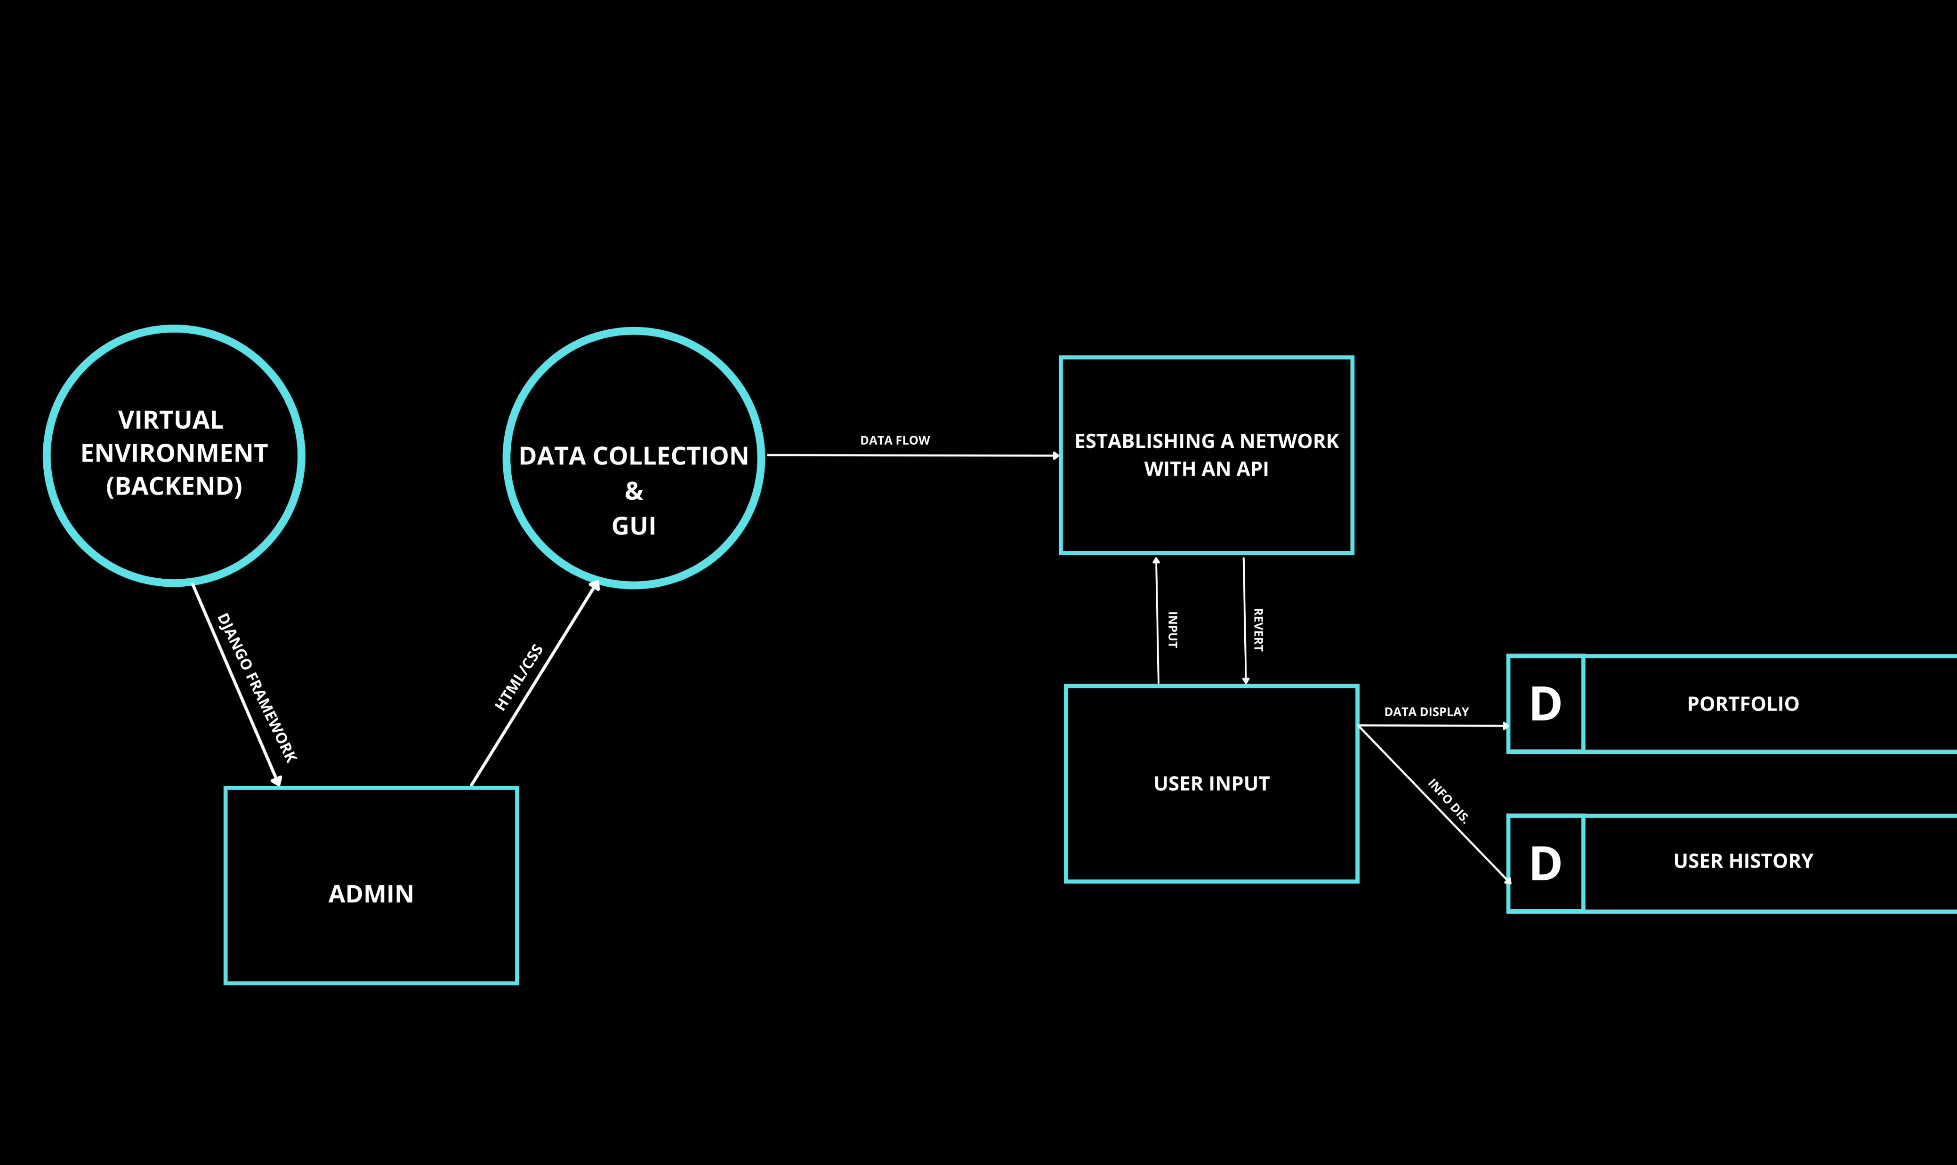

Slide 14
FLOW CHART OF IMPLEMENTATION

Slide 15
Stock Recommender
Support Page
Contact Us
Chat Bot
FAQ Only
News Tab
STOCK
UPDATES
STOCK COMPARE.
Virtual Environment
(Back-end)
Admin
(Back-end)
Add (Button)
Stock Search (Button)
Compare (Button)
Navigation Bar
Del. (Button)
My Holdings (Redirect)
Sell (Button)
Proposed Features
Compare (Button)
Progress Planned
Display Stock Webpage
Proposed Achieved
Stock API
Homepage Display
Stock Details (Same Webpage)

Slide 16
IMPLEMENTATION

Slide 17
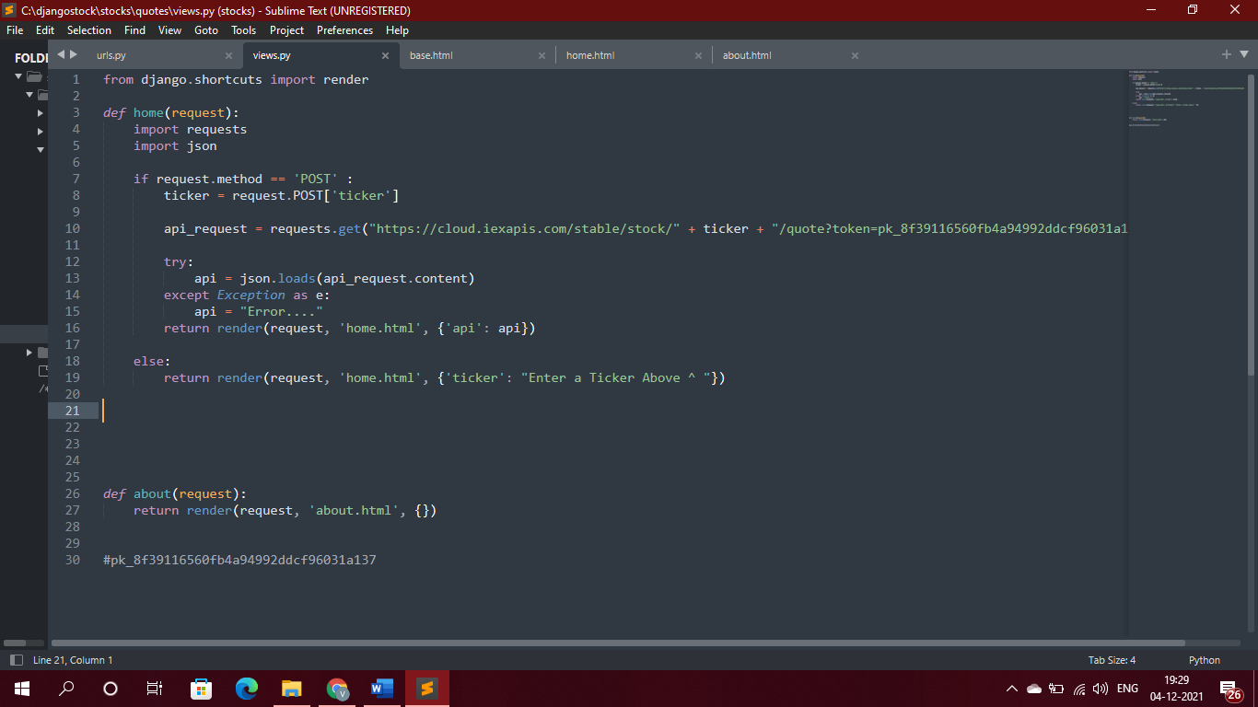

Slide 18
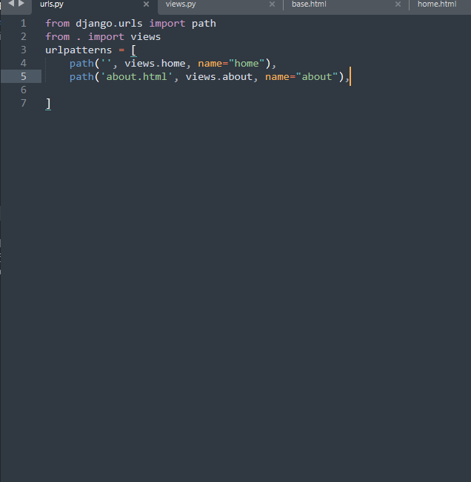

Slide 19
RESULTS

Slide 20
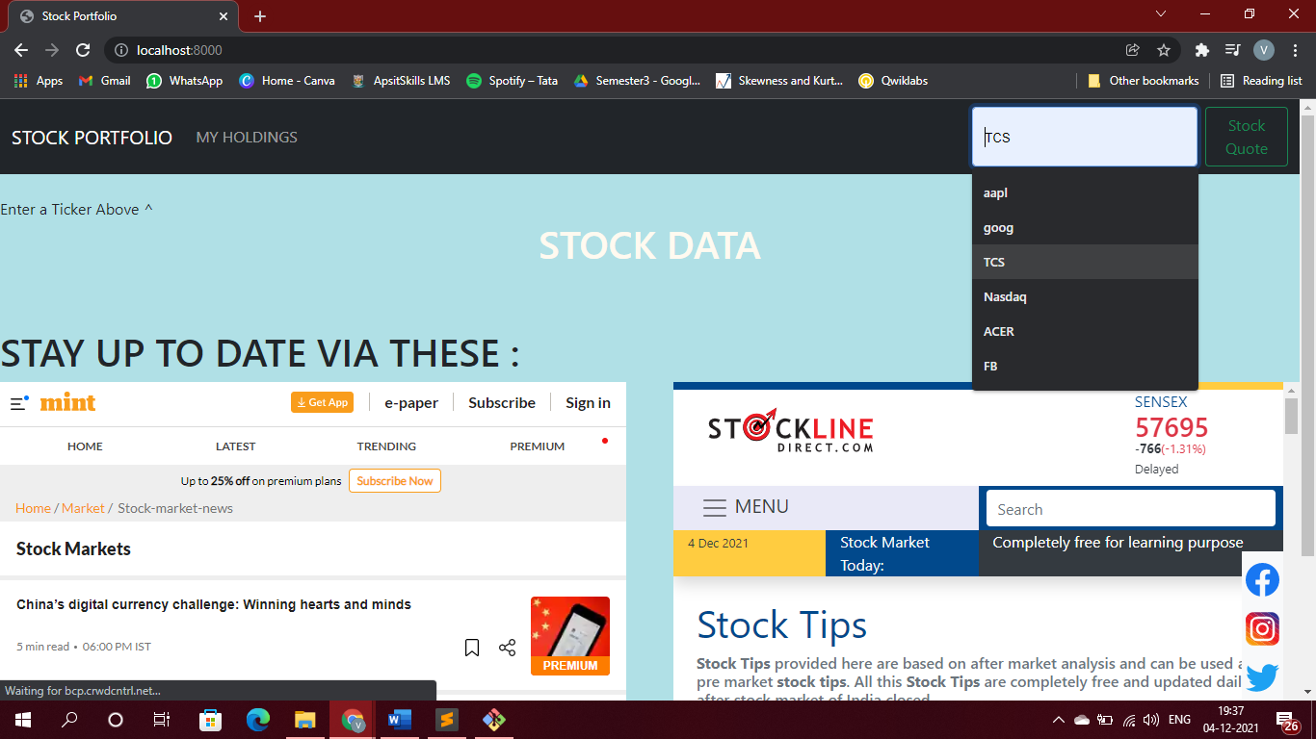

Slide 21
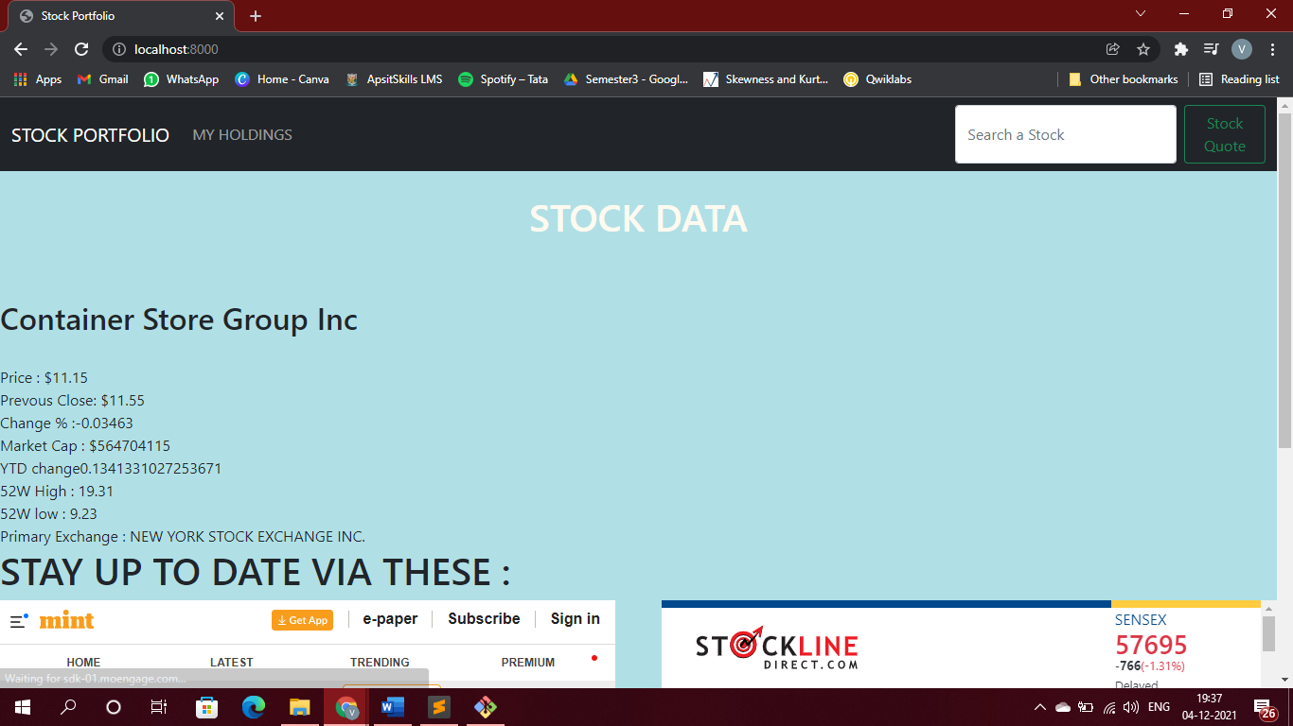

Slide 22
Thank You

